Slide 1
DSA KICKSTART
BUILDING STRONG FOUNDATIONS
TOPIC : LOOPS, FUNCTIONS AND METHODS
PRESENTED BY : SHRUTI DESHPANDE

Slide 2
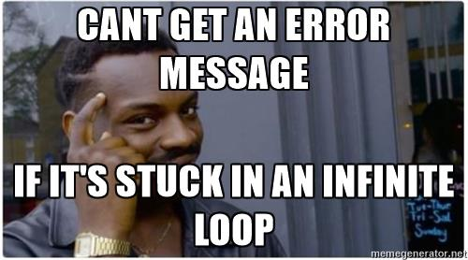
LOOPS
In computer programming, a loop is used to execute a group of instructions or a block of code multiple times, without writing it repeatedly.
The block of code is executed based on a certain condition. Hence, loops are the control structures of a program.

Slide 3
FOR LOOP
for loop in programming is a repetition control structure that allows programmers to write a loop that will be executed a specific number of times. for loop enables programmers to perform n number of steps together in a single line.
Examples of for loop in various languages:
Java
C++
Python
for (int i = 0; i < 5; i++) {
System.out.println("Iteration " + i);
}
for (int i = 0; i < 5; i++) {
cout << "Iteration " << i << endl;
}
for i in range(5):
print("Iteration", i)

Slide 4
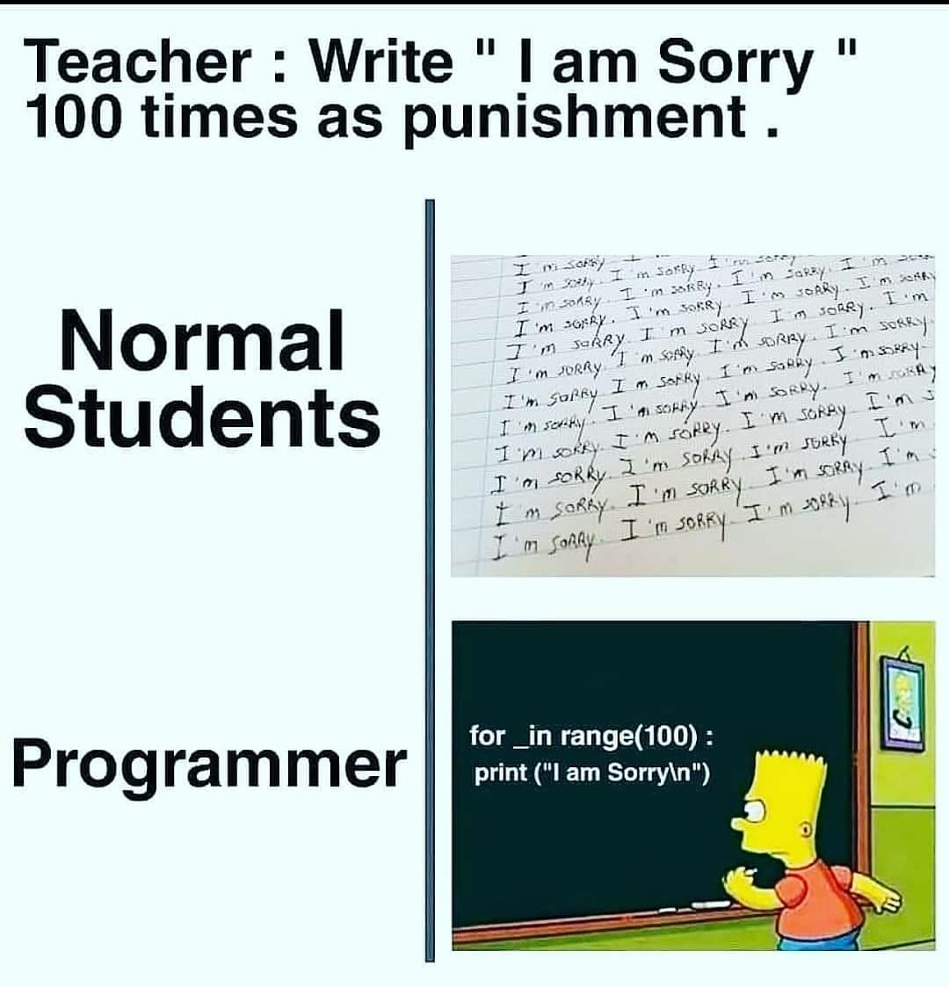

Slide 5
while LOOP
While loop does not depend upon the number of iterations. In for loop the number of iterations was previously known to us but in the While loop, the execution is terminated on the basis of the test condition.
Examples of while loop in various languages:
Java
C++
Python
int i = 0;
while (i < 5) {
System.out.println("Iteration " + i);
i++;
}
int i = 0;
while (i < 5) {
cout << "Iteration " << i << endl;
i++;
}
i = 0
while i < 5:
print("Iteration", i)
i += 1

Slide 6
Do-while LOOP
The do-while loop is similar to a while loop but the only difference lies in the do-while loop test condition which is tested at the end of the body. In the do-while loop, the loop body will execute at least once irrespective of the test condition.
Examples of do-while loop in various languages:
Java
C++
int i = 0;
do {
System.out.println("Iteration " + i);
i++;
} while (i < 5);
int i = 0;
do {
cout << "Iteration " << i << endl;
i++;
} while (i < 5);

Slide 7
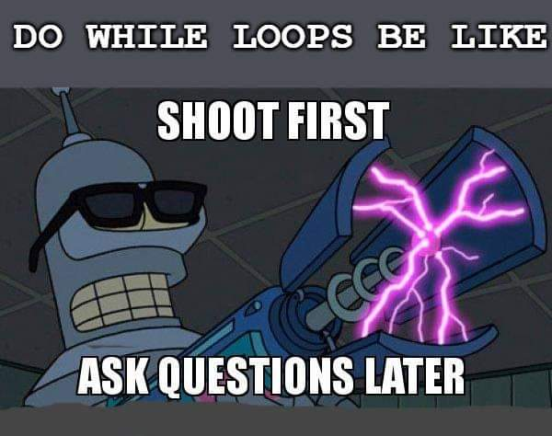

Slide 8
Control statements
Control statements in loops are used to manage the flow of execution within loop structures
These control statements help you alter the normal progression of a loop's iterations, allowing you to skip certain iterations, exit the loop prematurely, or execute additional code within the loop.

Slide 9
Break Statement:
In a loop, the "break" statement is used to terminate the loop prematurely. It is often used when a specific condition is met, and you want to exit the loop before it completes all its iterations.
Java
C++
public class BreakExample {
public static void main(String[] args) {
for (int i = 1; i <= 5; i++) {
if (i == 3) {
break; // This will exit the loop when i is 3
}
System.out.println(i);
}
}
}
#include <iostream>
int main() {
for (int i = 1; i <= 5; i++) {
if (i == 3) {
break; // This will exit the loop when i is 3
}
std::cout << i << std::endl;
}
return 0;
}

Slide 10
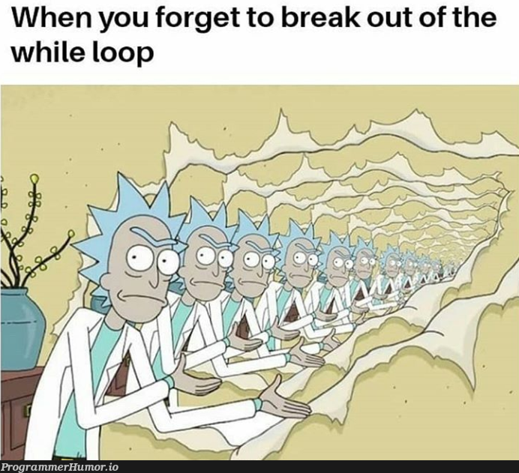

Slide 11
Continue Statement:
The "continue" statement is used to skip the current iteration of a loop and move to the next iteration. It is commonly used when a specific condition is met, and you want to skip the remaining code for that iteration.
Java
C++
public class ContinueExample {
public static void main(String[] args) {
for (int i = 1; i <= 5; i++) {
if (i == 3) {
continue; // This will skip the current iteration when i is 3
}
System.out.println(i);
}
}
}
#include <iostream>
int main() {
for (int i = 1; i <= 5; i++) {
if (i == 3) {
continue; // This will skip the current iteration when i is 3
}
std::cout << i << std::endl;
}
return 0;
}

Slide 12
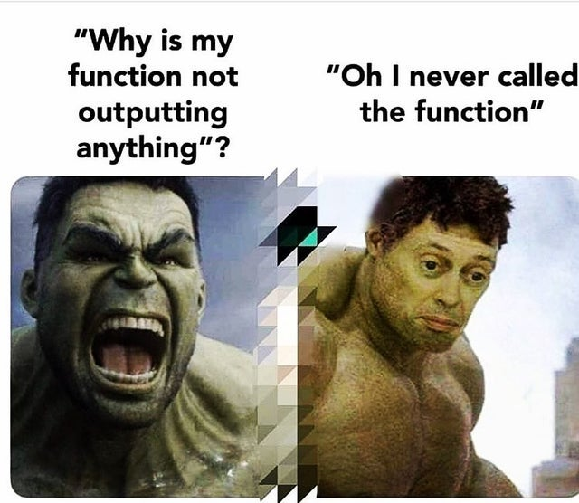
functions
Functions are "self contained modules of code that accomplish a specific task. Functions usually "take in" data, process it, and "return" a result. Once a function is written, it can be used over and over and over again. Functions can be "called" from the inside of other functions.

Slide 13
Creating a functions
Creation of a function generally involves the following steps:
Return Type − A function may return a value. The return_type is the data type of the value the function returns. Some functions perform the desired operations without returning a value. In this case, the return_type is the keyword void.
Function Name − This is the actual name of the function. The function name and the parameter list together constitute the function signature.
Parameter List − A parameter is like a placeholder. When a function is invoked, you pass a value as a parameter. This value is referred to as the actual parameter or argument. The parameter list refers to the type, order, and number of the parameters of a function. Parameters are optional; that is, a function may contain no parameters.
Function Body − The function body contains a collection of statements that defines what the function does.

Slide 14
Syntax :-
return_type Function_name(type param1, type param2)
{
\\body;
}
Return types :-
int: A function returning an integer.
double: A function returning a double-precision floating-point number.
char: A function returning a character.
string: A function returning a string.
bool: A function returning a boolean value (true or false).
void: A function that doesn't return any value.

Slide 15
Call by value
In "call by value," a copy of the actual value (or data) is passed to the function. The function works with this copy, not the original data.
#include <stdio.h>
// Function that takes two parameters a and b as inputs and returns their sum
int sum(int a, int b)
{
return a + b;
}
int main()
{
int add = sum(10, 30);
printf("Sum is: %d", add);
return 0;
}

Slide 16
public class Function {
public static void Multiplication(int a , int b){
int result = a *b;
System.out.println("Multiplication of giver two numbers is "+result );
}
public static void main(String args[]){
Multiplication(2, 6);
Multiplication(8, 9);
}
}

Slide 17
Call by reference
In "call by reference," a reference or memory address of the original data is passed to the function. The function operates on the actual data, not a copy.
void increment(int &x) {
x++; // Modifies the original 'num' variable outside the function.
}
int main() {
int num = 5;
increment(num);
// 'num' is now 6, as it was modified by the function.
}

Slide 18
Thank you

